Slide 1
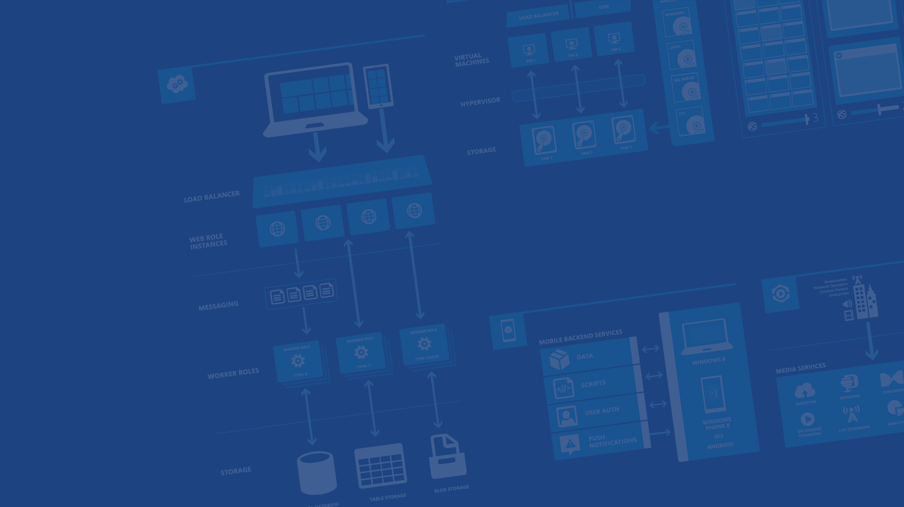
Building Bridges: Azure Service Bus
Runeet Vashisht
Dev Lead, Microsoft
Email : runeetv@microsoft.com
Twitter : @runeetv
Microsoft Azure

Slide 2
Agenda
Introduction
Service Bus Relay
Service bus Topics and Queues
Event Hub
Demo + Hands On

Slide 3



Windows Azure Service Bus
EASILY CONNECT APPLICATIONS
Queues for messaging occasionally connected devices like mobile phones
Topics & Subscriptions for publishing notifications to multiple subscribers
CONNECT APPLICATIONS FROM ANYWHERE
Connect applications across:
Public cloud
Public & private cloud
Private to private cloud through public cloud
Relay to securely call private cloud applications hosted behind firewalls and NATs
Clients can run on PCs, mobile devices or browser
Use various languages (.NET, WCF, REST, Java, Node.js, PHP)
ENTERPRISE GRADE CLOUD SERVICE
SaaS - No need for IT to change network config or install gateway devices
99.9% monthly SLA
Delivery assurance, reliable messaging, scale and load balancing
Claims based security and identity federation with Active Directory and web identities
Notes:
EASILY CONNECT APPLICATIONS
Service Bus Messaging provides out-of-the-box support for various messaging patterns that enable to easily connect applications
Queues offer a reliable, durable, and highly scalable way to store messages as they travel between systems without losing messages in case connectivity fails, one of the systems is down or is a mobile device with limited connectivity. Queues support multiple senders as well as multiple receivers with automatic load balancing.
Topics and Subscriptions implement a publish/subscribe pattern that delivers a highly scalable, flexible, and cost-effective way to publish messages from an application and deliver them to multiple subscribers.
Broadcast a message to hundreds or thousands of subscribers on a given Topic.
Distribute messages to individual subscribers or groups of Topic subscribers using message property based filtering rules.
Advanced messaging features provide a variety of options for delivery assurance and performance tuning:
Local Transactions
De-duplication
Scheduled delivery
Delivery confirmation (peek-lock)
Delivery deferral
Client-side pre-fetch
Batched Send/Receive
CONNECT APPLICATIONS FROM ANYWHERE
Service Bus enables connecting applications that are distributed across public cloud as well as hybrid environments, and various platforms, in a loosely coupled manner
Enables connecting application across public cloud, public cloud and private cloud, and private cloud to private cloud through public cloud.
Client applications can be running on PCs, mobile devices or in the browser.
Service Bus Relay enables applications to securely call into private cloud applications hosted in your own datacenter behind firewalls and NATs
Enterprises can use a SOA-based architecture and expose just the services they want to deliver from their private cloud environment which creates a more secure architecture than opening up a VPN.
Supports various programing languages and platforms: .NET, WCF, REST, Java (Coming soon: Node.js, PHP)
Supports a variety of different transport protocols and Web services standards, including REST, SOAP, and WS-*.
One-way messaging between sender and listener supports unicast and multicast.
Full-duplex connection-oriented sessions between sender and listener support bi-directional communication.
Services discoverable through a stable, internet-accessible URL, regardless of location.
ENTERPRISE GRADE CLOUD SERVICE
Managed service operated by Microsoft with 99.9% monthly SLA.
Service Bus takes care of delivery assurance, reliable messaging, scale and load balancing.
Claim based security using the Windows Azure Access Control service supports identity federation with Active Directory as well as common web identity providers like Google, Yahoo and Facebook.
Cloud hosted service relay and brokered messaging capabilities can be leveraged directly from anywhere without the need for IT to change network configuration or install gateway agents/devices.

Slide 4
Windows Azure Service Bus
Service Bus
Service Bus Relay:
Scenario: You have on-premise systems that you need to communicate with directly from outside your organization…
Solution: Internal Web Services are exposed securely via the Relay which passes calls into the on-premise service and back to the calling clients
Relay: Two Way Call into On-Premise Service
//
//
Service Bus Queues:
Scenario: Multiple systems and remote clients need to send business events to head office which processes these messages under varying load.
Solution: Queues decouple senders from receivers, multiple receivers can handle varying load, simple to add new senders without impact.
Message Queue: FIFO Resilient Queue
D
C
B
A
E
Service Bus Topics:
Scenario: Multiple actions have to be taken as a result of incoming messages from external systems but these actions frequently change.
Solution: Topics are special queues that have subscriptions which contain rules to determine which messages a subscription will contain.
Topic: Queue with 1:n rule based subscriptions
Notes:
An overview slide that covers the THREE main capabilities of SB and an example scenario of where this might be used. Sometimes you might only need this slide to explain, or just use it as a simple t-up slide before you go into the details of how each of these capabilities works at a high level.

Slide 5
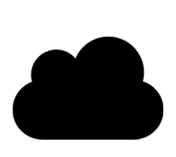

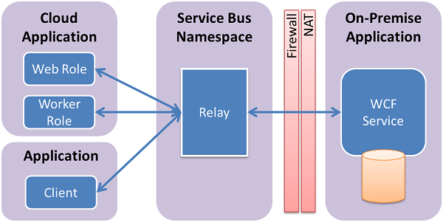

Service Bus Relay
Exposes WCF service residing within a corporate enterprise network to public cloud.
Does not require to open up a firewall connection or make any changes to the corporate network infrastructure.
Enables to build hybrid applications that run both on Windows Azure data center and on your own On-premise enterprise environment.

Slide 6



Service Bus Relay
Text
XML
Graphics
Binary Data
Streams
Azure
Relay Service
Send
Send
Receive
Receive
Application A
Application B
Direct Connection if possible

Slide 7
Queue
S
R
Queue
Multiple sender/reciever on a single queue

Slide 8
Topics
S
Sub
R
Topic
Sub
Sub
Multiple subscribers each with own cur/locks
Subscribers can filter with expressions on properties
Competing Consumers on each subscription
Register filter rules /subscription basis.

Slide 9
Why Topics?
R
R
S
Sub
R
Topic
R
Sub
Sub
R
Message Distribution
Each receiver gets its own copy of each message. Subscriptions are independent. Allows for many independent ‘taps’ into a message stream. Subscriber can filter down by interest.
Constrained Message Distribution (Partitioning)
Receiver get mutually exclusive slices of the message stream by creating appropriate filter expressions.

Slide 10
Topics-Basic Info
Creation
Using Management Portal
Receive Modes
ReceiveAndDelete
Filters
Filter conditions operate on message properties and are expressed in SQL’92 syntax
Using .NET API
Using REST calls
PeekLock
Decision=‘APPROVE’
Decision LIKE ‘ONHOLD%’
AppID > 11 OR AppName=‘ETRAX’
Powershell commandlets.

Slide 11
Limitations
256KB Message Limit including 64kb for headers
2000 subscriptions per topic
MAX 5 GB per topic
2000 filters per topic
concurrent receive requests on a queue/topic entity:5000
Notes:
https://msdn.microsoft.com/en-us/library/azure/ee732538.aspx

Slide 12
Other Features
Transactions
TTL
Co-Relation
Enqueue-Scheduling
Sessions
Dead-Lettering
Duplicate Detection

Slide 13
Hand On
Azure Service Bus

Slide 14
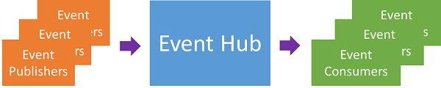
Event Hub
Strongly biased towards high throughput and event processing scenarios

Slide 15
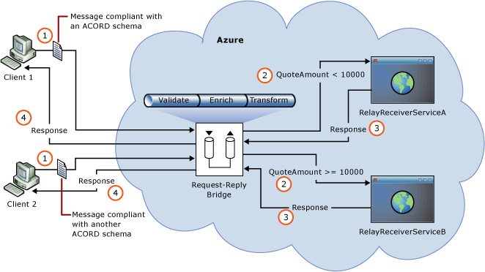
Azure BizTalk Services
Provides common integration capabilities (e.g. bridges, transforms, B2B messaging) on Microsoft Azure.

Slide 16
Runeet Vashisht
Dev Lead, Microsoft.
Email : runeetv@microsoft.com
Twitter : @runeetv

